Slide 1
File System Implementation

Slide 2
Introduction
File system implementation defines how files and directories are stored, how disk space is managed, and how to make everything work efficiently and reliably.
A file can be defined as a data structure which stores the sequence of records. Files are stored in a file system, which may exist on a disk or in the main memory. Files can be simple (plain text) or complex (specially-formatted).
The collection of files is known as Directory . The collection of directories at the different levels, is known as File System .

Slide 3
File Attributes
1.Name
Every file carries a name by which the file is recognized in the file system. One directory cannot have two files with the same name.
2.Identifier
Along with the name, Each File has its own extension which identifies the type of the file. For example, a text file has the extension .txt, A video file can have the extension .mp4.
3.Type
In a File System, the Files are classified in different types such as video files, audio files, text files, executable files, etc.
4.Location
In the File System, there are several locations on which, the files can be stored. Each file carries its location as its attribute.

Slide 4
5.Size
The Size of the File is one of its most important attribute. By size of the file, we mean the number of bytes acquired by the file in the memory.
6.Protection
The Admin of the computer may want the different protections for the different files. Therefore each file carries its own set of permissions to the different group of Users.
7.Time and Date
Every file carries a time stamp which contains the time and date on which the file is last modified.

Slide 5
Operations on the File
1.Create
Creation of the file is the most important operation on the file. Different types of files are created by different methods for example text editors are used to create a text file, word processors are used to create a word file and Image editors are used to create the image files.
2.Write
Writing the file is different from creating the file. The OS maintains a write pointer for every file which points to the position in the file from which, the data needs to be written.
3.Read
Every file is opened in three different modes : Read, Write and append. A Read pointer is maintained by the OS, pointing to the position up to which, the data has been read.

Slide 6
4.Re-position
Re-positioning is simply moving the file pointers forward or backward depending upon the user's requirement. It is also called as seeking.
5.Delete
Deleting the file will not only delete all the data stored inside the file, It also deletes all the attributes of the file. The space which is allocated to the file will now become available and can be allocated to the other files.
6.Truncate
Truncating is simply deleting the file except deleting attributes. The file is not completely deleted although the information stored inside the file get replaced.

Slide 7
Directory Structure
Directory can be defined as the listing of the related files on the disk. The directory may store some or the entire file attributes.
A directory is a location for storing files on your computer.
To get the benefit of different file systems on the different operating systems, A hard disk can be divided into the number of partitions of different sizes. The partitions are also called volumes or mini disks.
Each partition must have at least one directory in which, all the files of the partition can be listed.
A directory entry is maintained for each file in the directory which stores all the information related to that file.

Slide 8
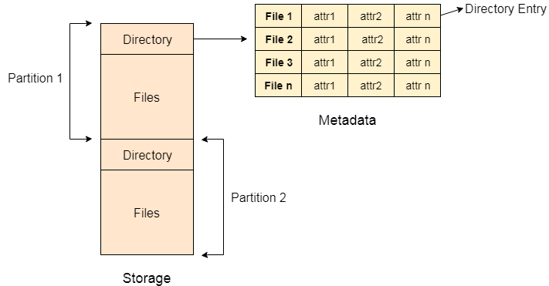

Slide 9
Every Directory supports a number of common
operations on the file:
File Creation
Search for the file
File deletion
Renaming the file
Traversing Files
Listing of files

Slide 10
File System Structure
File system is the part of the operating system which is responsible for file management. It provides a mechanism to store the data and access to the file contents including data and programs.

Slide 11
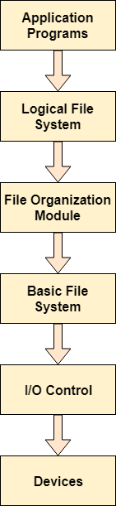

Slide 12
When an application program asks for a file, the first request is directed to the logical file system. The logical file system contains the Meta data of the file and directory structure. If the application program doesn't have the required permissions of the file then this layer will throw an error. Logical file systems also verify the path to the file.
Generally, files are divided into various logical blocks. Files are to be stored in the hard disk and to be retrieved from the hard disk. Hard disk is divided into various tracks and sectors. Therefore, in order to store and retrieve the files, the logical blocks need to be mapped to physical blocks. This mapping is done by File organization module. It is also responsible for free space management.
Once File organization module decided which physical block the application program needs, it passes this information to basic file system. The basic file system is responsible for issuing the commands to I/O control in order to fetch those blocks.
I/O controls contain the codes by using which it can access hard disk. These codes are known as device drivers. I/O controls are also responsible for handling interrupts.

Slide 13
Directory implementation
There is the number of algorithms by using which, the directories can be implemented. However, the selection of an appropriate directory implementation algorithm may significantly affect the performance of the system.
The directory implementation algorithms are classified according to the data structure they are using. There are mainly two algorithms which are used in these days.

Slide 14
Linear List
In this algorithm, all the files in a directory are maintained as singly lined list. Each file contains the pointers to the data blocks which are assigned to it and the next file in the directory.

Slide 15
Characteristics
When a new file is created, then the entire list is checked whether the new file name is matching to a existing file name or not. In case, it doesn't exist, the file can be created at the beginning or at the end. Therefore, searching for a unique name is a big concern because traversing the whole list takes time.
The list needs to be traversed in case of every operation (creation, deletion, updating, etc) on the files therefore the systems become inefficient.

Slide 16
Hash Table
To overcome the drawbacks of singly linked list implementation of directories, there is an alternative approach that is hash table. This approach suggests to use hash table along with the linked lists.
A key-value pair for each file in the directory gets generated and stored in the hash table. The key can be determined by applying the hash function on the file name while the key points to the corresponding file stored in the directory.
Now, searching becomes efficient due to the fact that now, entire list will not be searched on every operating. Only hash table entries are checked using the key and if an entry found then the corresponding file will be fetched using the value.

Slide 17
Allocation methods
Allocation methods can be used to allocate disk space to the files. Selection of an appropriate allocation method will significantly affect the performance and efficiency of the system. Allocation method provides a way in which the disk will be utilized and the files will be accessed.
There are three major methods of allocating disk space.

Slide 18
Contiguous Allocation
If the blocks are allocated to the file in such a way that all the logical blocks of the file get the contiguous physical block in the hard disk then such allocation scheme is known as contiguous allocation.
In the image shown below, there are three files in the directory. The starting block and the length of each file are mentioned in the table. We can check in the table that the contiguous blocks are assigned to each file as per its need.

Slide 19
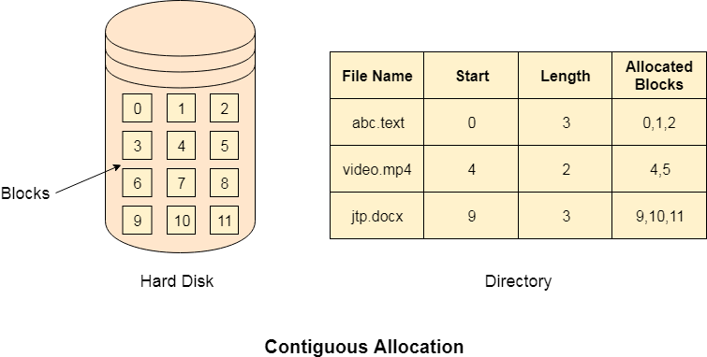

Slide 20
Advantages
It is simple to implement.
We will get Excellent read performance.
Supports Random Access into files.
Disadvantages
The disk will become fragmented.
It may be difficult to have a file grow.

Slide 21
Linked Allocation
Linked allocation solves all problems of contiguous allocation. In linked list allocation, each file is considered as the linked list of disk blocks. However, the disks blocks allocated to a particular file need not to be contiguous on the disk. Each disk block allocated to a file contains a pointer which points to the next disk block allocated to the same file.

Slide 22
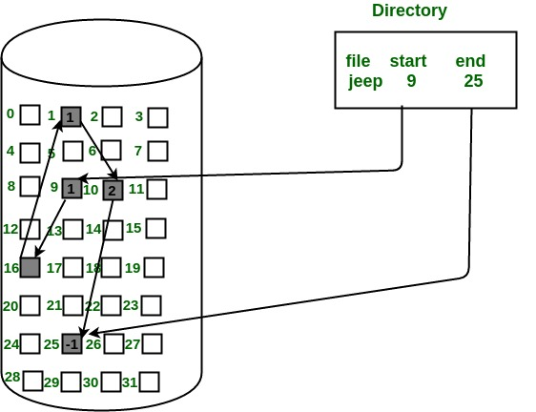

Slide 23
Advantages
There is no external fragmentation with linked allocation.
Any free block can be utilized in order to satisfy the file block requests.
File can continue to grow as long as the free blocks are available.
Directory entry will only contain the starting block address.
Disadvantages
Random Access is not provided.
Pointers require some space in the disk blocks.
Any of the pointers in the linked list must not be broken otherwise the file will get corrupted.
Need to traverse each block.

Slide 24
Indexed Allocation
Instead of maintaining a file allocation table of all the disk pointers, Indexed allocation scheme stores all the disk pointers in one of the blocks called as indexed block. Indexed block doesn't hold the file data, but it holds the pointers to all the disk blocks allocated to that particular file. Directory entry will only contain the index block address.

Slide 25
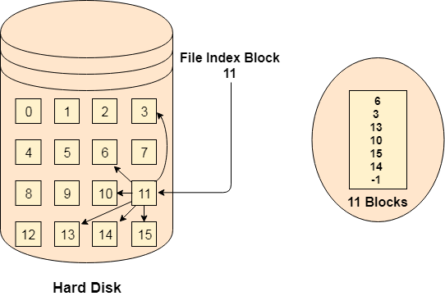

Slide 26
Advantages
Supports direct access
A bad data block causes the lost of only that block.
Disadvantages
A bad index block could cause the lost of entire file.
Size of a file depends upon the number of pointers, a index block can hold.
Having an index block for a small file is totally wastage.
More pointer overhead

